Slide 1
Artificial Intelligence
Fuzzy Logic
ADF – Start 08:30
Notes:
Assalaamu'alaikum warohmatullahi wabarokatuh my friends.
I am Hendy Irawan. Welcome to Introduction to Artificial Intelligence. We're still in Reasoning algorithms, and today we will learn about Fuzzy Logic.
This slides are prepared by Mr. Anditya. Alright, let's get started.

Slide 2
What is Fuzzy Logic?
Notes:
Fuzzy logic is one of the most popular reasoning algorithms. Let's find out why we want to use it and how it works.

Slide 3
Fuzzy Logic
Experts rely on common sense when they solve problems.
“People do not require precise, numerical information input, and yet they are capable of highly adaptive control.”
Professor Lotfi Zadeh, UC Berkeley, 1965
Notes:
Human experts usually rely on common sense.
Meaning, they don't always require precise information, input, and output.
Humans tend to be adaptive.
This is in contrast with computers and algorithms.

Slide 4
Fuzzy Logic
How can we represent expert knowledge that uses vague and ambiguous terms in a computer?
Accepts noisy, imprecise input!
Decisions based on “degree of truth”
Graded truth.
Truth values between True and False.
Not everything is either/or, true/false, black/white, on/off etc.
Notes:
The question for these kinds of problems becomes:
"How can we represent expert knowledge that uses vague and ambiguous terms in a computer?"
And the answer is:
First, computers need to learn to accept noisy, imprecise input.
And second, based on that input, computers need to be able to decide not just strict true or false,
but also "graded truth".
Meaning Truth values between True and False.
Because Not everything is either/or, true/false, black/white, on/off etc.
How to make computer understand there are things in between these true and false?

Slide 5
Fuzzy Logic
Fuzzy logic is based on the idea that all things admit of degrees.
Temperature, height, speed, distance, beauty
all come on a sliding scale.
Model uncertainty in natural language.
The motor is running really hot.
Tom is a very tall guy.
Notes:
Examples of this "things in between" are:
Temperature (very cold, quite cold, very hot)
height (quite short, quite tall, very tall)
speed (very slow, normal, fast)
distance (near, a bit far, very far)
beauty (beautiful, really beautiful, gorgeous)
and so on, you get the idea!

Slide 6
Fuzzy Logic
Reasoning using linguistic terms. Natural to express expert knowledge.
If the weather is cold, then wear warm clothing
Notes:
Not only the terminology, but the reasoning itself is using linguistic terms.
So instead of saying if temperature is less than 2.52 degrees, we want to say:
If the weather is cold, then wear warm clothing
But this makes us ask the question, how do a computer knows what is "cold"?
And what happens if the temperature is somewhere between "cold" and "normal"?
What will the computer decide?

Slide 7
Fuzzy Logic
Fuzzy logic is not logic that is fuzzy, but logic that is used to describe fuzziness.
Fuzzy logic is the theory of fuzzy sets, sets that calibrate vagueness.
It’s not a method for reasoning under uncertainty
that’s probability
Notes:
To be clear: fuzzy logic algorithm itself is not fuzzy, it's a very clear algorithm.
But this fuzzy logic algorithm describes fuzziness.
Fuzzy logic itself, is, the theory of fuzzy sets, or sets that calibrate vagueness.
Warning: This is NOT uncertainty. That's probability.
Probability is like, the probability that when you roll a dice, you get a 6.
So you either get a 6, or not. You can't get a 5.5 in dice, right.
But fuzzy is for a grade of values.
You can say 39 degrees Celcius is hot, but 38.5 degrees Celcius is also hot or quite hot.
I hope that clears up how to distinguish between probability and fuzzy.

Slide 8
Fuzzy Logic
Fuzzy set theory resembles human reasoning in its use of approximate information and uncertainty to generate decisions.
It was specifically designed to mathematically represent uncertainty and vagueness and provide formalized tools for dealing with the imprecision intrinsic to many problems.
Notes:
[skip]

Slide 9

Soft Computing
Evolving collection of methodologies, which aims to exploit tolerance for imprecision, uncertainty, and partial truth to achieve robustness, tractability and low cost
[Lotfi A. Zadeh, 2006]
Notes:
[skip]

Slide 10
Notes:
Fuzzy logic belongs to a computing field called Soft computing.
And this supports other fields including probabilistic reasoning, neural networks, chaos theory, and evolutionary computation.
-----------------------------------

Slide 11
Case Example that can be solved using Fuzzy
Notes:
Let's take a look at what problems we can solve using fuzzy logic.

Slide 12
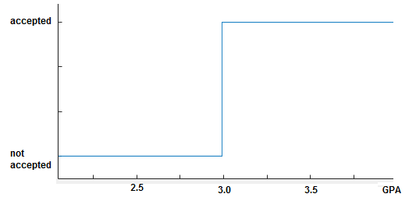
Scholarship Selection
A university wants to provide some scholarships to their outstanding students
Define classical rule
Select students based on their current GPA
if GPA >= 3.0 then
accept
Notes:
A university wants to provide some scholarships to their outstanding students.
Several students have applied to the scholarship program.
Let's assume we don't use fuzzy logic.
What criteria can we use to accept or reject the applicants?
Let's say, based on their GPA, or IPK, ok?
If GPA is 3.0 or greater, then we accept the scholarship application.
As you can see in the chart on the right, this represents the GPA number.
And this represents the output of the decision.
Up to below 3.0, the result is not accepted.
And 3.0 or above, the result is accepted.
Simple, right?

Slide 13
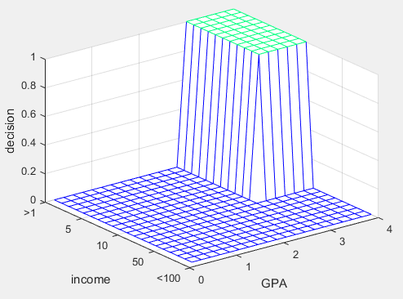
Scholarship Selection
The selection criteria is too broad, add more parameter
Add more classic rule
Select students based on their parent’s income
if GPA >= 3.0 and income<10 then
accept
Notes:
But what if we want prioritize students who have low family income?
We can add a rule, like this, so not only GPA needs to be 3.0 or higher,
the income must be less than 10 (million rupiahs).
Good enough for now?

Slide 14
Scholarship Selection
Then come a specific case:
Candidate | GPA | Parents’ Income IDR/month
A | 3.00 | 9,500,000
B | 2.98 | 1,000,000
if GPA >= 3.0 and income<10 then
accept
Notes:
But then, we find a case where a student's family is really poor,
but the GPA is very near to 3.0, and we actually want to accept this student,
rather than a student with GPA 3.0 but comes from a rich family.
This rule doesn't work.

Slide 15
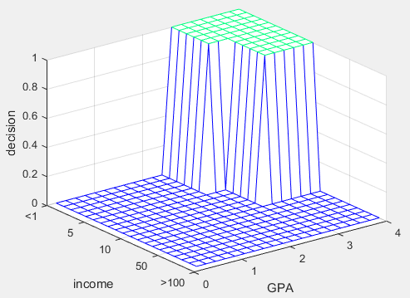
Scholarship Selection
Then come a specific case:
add a new rule
Candidate | GPA | Parents’ Income IDR/month
A | 3.00 | 9,500,000
B | 2.98 | 1,000,000
if (GPA >= 3.0 and income<10) or
(GPA>=2.5 and income<5)
then
accept
Notes:
We can add a rule…
So if GPA is 3.0 or above we accept if income is below 10,
but if income is below 5, then we can accept if GPA is minimum 2.5.
You can see the rules are already getting more complex here.

Slide 16
Scholarship Selection
What if the University can only provide 5 scholarships, and there are 6 qualified applicants?
if (GPA >= 3.0 and income<10) or
(GPA>=2.5 and income<5)
then
accept
Notes:
Now what if we only have 5 scholarship slots,
but after using selecting using the hard logic,
we get 6 applicants that are qualified.
Who to keep, and who to drop?

Slide 17
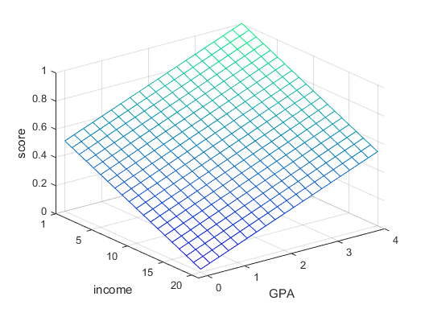
Scholarship Selection
What if the University can only provide 5 scholarships, and there are 6 qualified applicants?
Change the binary decision to a scoring system [0,1]
Score = (GPA/4 + (20-income)/19)/2
Notes:
We can try changing the if/else criteria into scoring system formula.
For example: (GPA/4 + (20-income)/19)/2

Slide 18
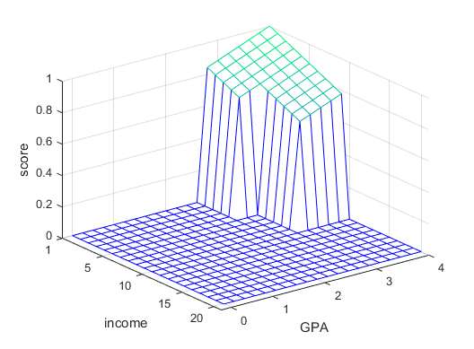
Scholarship Selection
Combine and Adjust to original rule:
if (GPA >= 3.0 and income<10) or
(GPA>=2.5 and income<5)
then
score = (GPA/4+(20-income)/19)/2
else
score = 0
Notes:
Now it becomes a combination of if/else and scoring formula.

Slide 19

Scholarship Selection
More specific cases?
Further modifying the rule to adapt the situation
if(GPA>=2.5 and income<6) then
score = 2*(20-income)/19-0.8;
if(GPA>=3 and income<6) then
score = (20-income)/19
if(GPA<3 and 6<income<10) then
score = (GPA/4+(20-income)/19)/2;
Notes:
But what happens if we have more rules?
Can you see where we're going with this?
The rules are getting more complex and it's getting harder to understand the logic and formula,
and it's more difficult to change too.
And is easier to make mistakes here because it's easy to get confused.

Slide 20
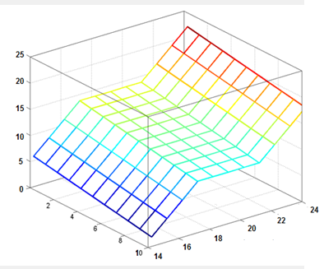
Scholarship Selection
Extended Rule
Complicated function
Not easy to modify
Not intuitive
Many hard-coded parameters
Not easy to understand
Fuzzy can help this
Notes:
The conclusion is, when we use normal rules for reasoning problems like this, we get:
Complicated function
Not easy to modify
Not intuitive
Many hard-coded parameters
Not easy to understand
That's where fuzzy logic comes to save your problem, yay!
-------------------------------

Slide 21
Fuzzy Value and Fuzzy Set
Notes:
The first concepts that you need to understand, are
fuzzy value, and
fuzzy set

Slide 22
Fuzzy, Crisp, and Probability
Crisp Facts
clear and distinct boundaries
“either-or”
Fuzzy Facts
imprecise boundaries
“more-or-less”
Probability
incomplete facts
“might-be”, “chance”
Notes:
The normal facts that we learned in propositional logic and first-order logic,
they are crisp facts.
Like weather is hot, weather is cold, Andi is tall, Andi is short.
But fuzzy facts, they have a grading, a "temperature" can be hot or cold, or something in between.
Someone's "height" can somewhere between very tall and very short.
This is different than probability ya.
Probability is for "might be" or a "chance".
There's a chance that weather is cold today. But it might not be cold.
We're talking about the probability of cold weather, not about the intensity of coldness.

Slide 23
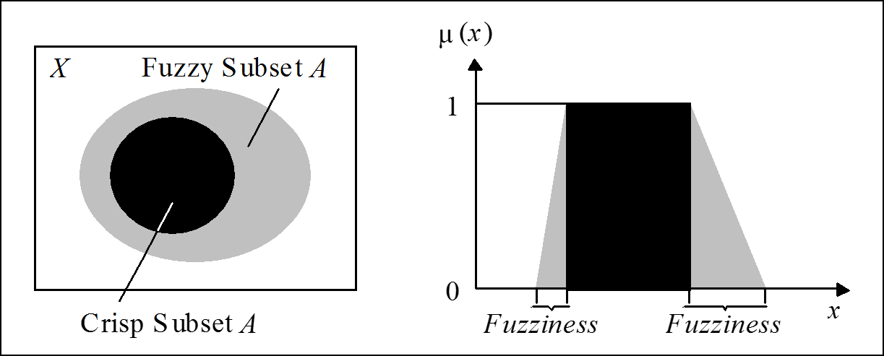
Fuzzy vs Crisp value
Crisp value has distinct boundary between 1 and 0
Fuzzy vale consist of a crisp value, and a gray area to bridge the values
Notes:
Now we have the concept of crisp value and fuzzy value.
As you can see here, a fuzzy value consists of a crisp value,
but also there's "gray" area that transitions the value between 0 to 1.
These gray area are the fuzziness.

Slide 24
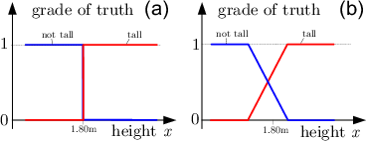
Fuzzy vs Crisp value
Notes:
If we look at crisp sets here. In height, we have short, average, and tall.
The ranges are crisp.
There is no mistaking, if the height is 169 cm, that is short. Not average, not tall.
But when we use fuzzy sets concept, things can be mixed in grade of truth.
For height 169 cm, if you see here, that is about 0.1 short, or 10% of shortness,
and is about 0.4 average, or 40% of averageness.
So it's both short and average, has membership degree in both short and average.
It's still possible to be, for example, 190 cm, where that would be 100% tall,
and 0% short and 0% average. But as you can see here, most height values
become multiple memberships with varying degree in each of short, average, and tall.

Slide 25
Fuzzy vs Probability
Probability
likelihood that a future event will occur
Probability event is in a set
Fuzzy Logic
Measures ambiguity of event that has already occurred
Degree of membership in a set
Notes:
To review,
probability is about likelihood, or chance, or "might-be".
And fuzzy logic deals with degree of membership in a set.

Slide 26
Linguistic Variables
A linguistic variable is a fuzzy variable
A variable whose values are words or sentences in a natural or artificial language
Age is a linguistic variable if its values are linguistic rather than numerical,
i.e., young, not young, very young, quite young, old, not very old and not very young, etc.,
rather than 20, 21,22, 23
Notes:
After concept of fuzzy value, there is a concept of linguistic variable.
A linguistic variable has values that are words or sentences in a natural or artificial language, not numbers.
For example: young, not young, very young, quite young, old, not very old and not very young, etc.

Slide 27
Linguistic Variables
Treating Truth as a linguistic variable with values such as true, very true, completely true, not very true, untrue, etc., leads to what is called fuzzy logic.
By providing a basis for approximate reasoning, that is, a mode of reasoning which is not exact nor very inexact, such logic may offer a more realistic framework for human reasoning than the traditional two-valued logic.
Notes:
So fuzzy logic treats truth (which is normally true vs. false) as a linguistic variable,
meaning you get values ranging from "very false to somewhat true to very true".
This is the basis for "approximate reasoning", to solve problems that are closer to human reasoning,
than traditional true/false logic.
---------------

Slide 28
Membership Function
Notes:
The next concept we need to learn is Membership Function.

Slide 29
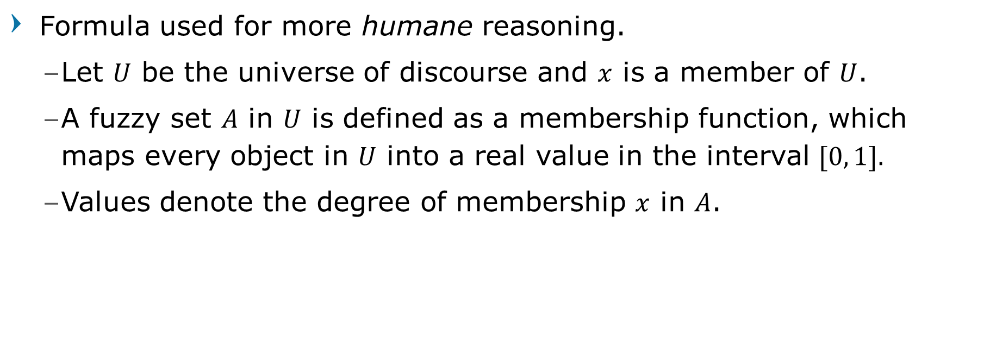
Membership Function
Formula used for more humane reasoning.
Let $U$ be the universe of discourse and $x$ is a member of $U$.
A fuzzy set $A$ in $U$ is defined as a membership function, which maps every object in $U$ into a real value in the interval $[0, 1].$
Values denote the degree of membership $x$ in $A$.
Notes:
Membership function is a formula, that maps a crisp value U into a fuzzy set A, and the value is interval from 0 to 1, inclusive.
Continuing our previous example.
Let's say the height is 169. And that means degree of membership in short is 0.1,
degree of membership in average is 0.4, and degree of membership in tall is 0.0.
Now we need three membership functions here, let's call them:
u short, for the short membership
u average, for the average membership
u tall, for the tall membership
The input for all of these functions is the height, for example 169 cm or 175 cm.
And the function result is a number between 0 to 1, indicating membership in short, average, or tall.

Slide 30

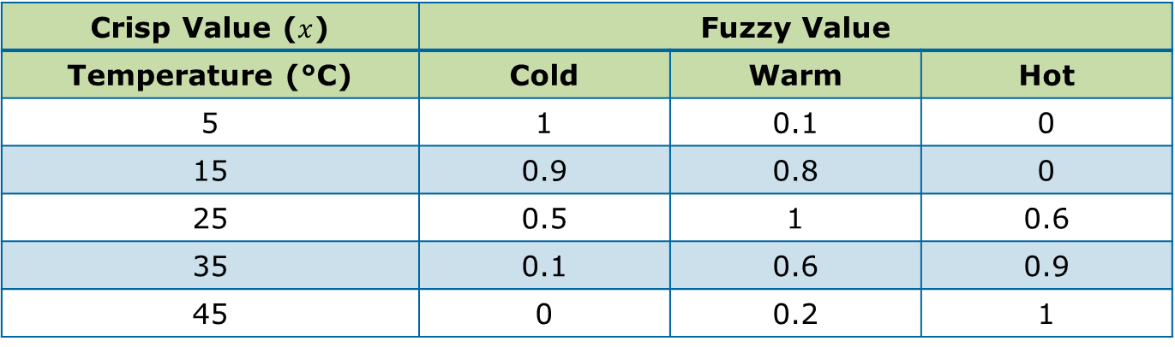
Degree of Membership Example
$U$ is universe of discourse of temperature $[−∞, ∞]$
A is a Fuzzy set Temperature with 3 Linguistics: Cold, Warm, Hot
Fuzzy set maps $U$ into $A$ as degree of membership in range of [0,1]
Crisp Value ($x$) | Fuzzy Value
Temperature (°C) | Cold | Warm | Hot
5 | 1 | 0.1 | 0
15 | 0.9 | 0.8 | 0
25 | 0.5 | 1 | 0.6
35 | 0.1 | 0.6 | 0.9
45 | 0 | 0.2 | 1
Notes:
This is another example.
We have input, crisp value that is temperature.
And we have fuzzy set temperature, with 3 linguistics: cold, warm, and hot.
This means how many membership functions we need for temperature? Three.
We need a membership function for cold, and warm, and also hot.
So these functions, when given an input of 5, for cold will result in 1, for warm function will result in 0.1,
and for hot function will return 0.

Slide 31
Membership Functions
Membership function usually described as a mathematical graph function
Linear Function:
Triangles, Trapezoidal
Sigmoid Function and Bell Function:
Phi, Beta, Gauss
Notes:
Membership function is usually described as a linear function.
Although it's possible to use sigmoid and bell function.

Slide 32
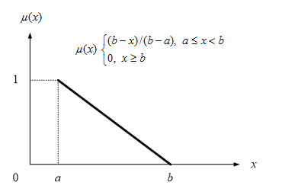
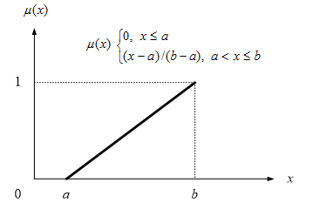
Linear Membership Function
Illustrates linear progression in fuzzy value that bridge one value to another
Notes:
The example on the right is membership function that is decreasing
from 1 when input is a,
to 0 when input is b.
You usually use this shape for linguistic that is the beginning/lower edge.
The example on the left is membership function that is increasing from 0 when input is a,
to 1 when input is b.
You usually use this shape for linguistic that is the ending/higher edge.

Slide 33
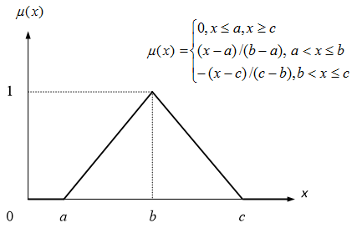
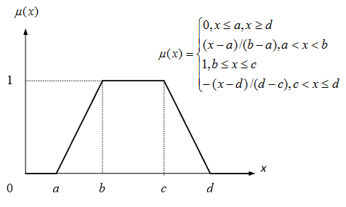
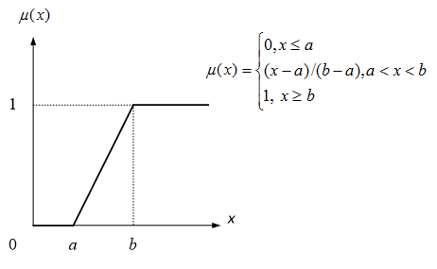
Linear Membership Function
Combination of two linear membership function make the function looks triangular or trapezoidal
Notes:
We can combine increasing dan decreasing function result,
so the shape looks triangular or trapezoidal.
Usually this is used for linguistic in the middle, but
can also be used for beginning or ending.

Slide 34
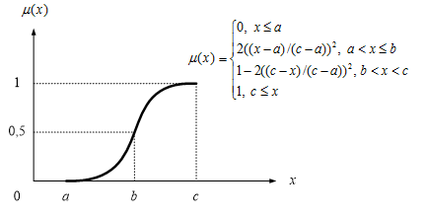
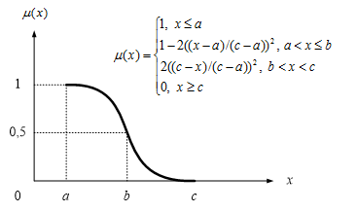
Sigmoid Membership Function
Illustrates progression from small beginnings that accelerates and approaches a climax over time
When a specific mathematical model is lacking, a sigmoid function is often used
Notes:
Other than linear, sigmoid function can also be used.
This gives a smooth curve.

Slide 35
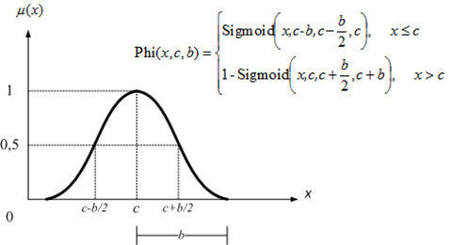
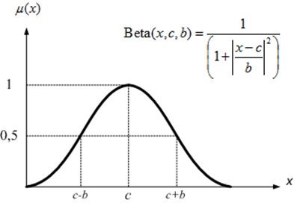
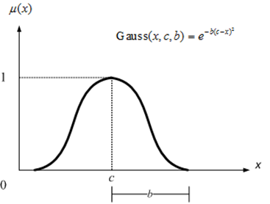
Sigmoid Membership Function
Various functions to represent sigmoid such ass bell and gaussian
Notes:
Other nonlinear functions can be used like beta and gaussian.
--------------------------

Slide 36
Building Fuzzy System
Notes:
We have learned the fundamental concepts that are fuzzy sets, fuzzy values, and membership functions.
Let's see how fuzzy logic works.

Slide 37
Fuzzy System
Consist of 3 main process
Fuzzification
Transform crisp input into fuzzy values based-on its corresponding Membership Function
Inference
Determine the fuzzy output using predefined rule
Defuzzification
Transform back the output fuzzy value into crisp value
Notes:
In a fuzzy system, there are 3 processes: fuzzification, inference, and defuzzification.
In fuzzification, the inputs are crisp values, and we have membership functions for each linguistic variable.
The fuzzification process transform crisp input into fuzzy values based-on its corresponding Membership Function.
In step 2, inference, we determine the fuzzy output using predefined rule.
In step 3, defuzzification, we transform back the output fuzzy value into crisp value.

Slide 38
Fuzzy System
To build a fuzzy system, we need to design and specify:
Number of input and output Linguistic
Input Membership Functions
Fuzzy Rules
Defuzzification Method
Output Membership Function
Ideally these rules and functions are provided by “the expert in the appropriate field”
Notes:
We need 5 components needed for building a fuzzy system:
Number of input and output Linguistic
Input Membership Functions
Fuzzy Rules
Defuzzification Method
Output Membership Function
-------------------------

Slide 39
Designing Fuzzy System for Scholarship Selection
For this example, let’s pretend that we are “the expert in this field”
Notes:
Let's take a look at an example, the scholarship selection.

Slide 40
Step 1: Determine the input and output
Just as the example has been given previously, the inputs for the selection are GPA and Parent’s income, while the output is the Acceptance score
Design the Linguistic Variable for each Input, let’s specify each into three (3) linguistics such as:
GPA: High, Average, Low
Income: Upper, Middle, Bottom
For the output, we design also three (3) Linguistic
Score: Accepted, Considered, Rejected
Notes:
First, we must design the inputs and outputs.
All inputs must be designed as linguistic variables, and also for the outputs.
In the scholarship scenario, we have two INPUT linguistic variables:
GPA: with linguistics high, average, and low
Income: with linguistics upper, middle, and bottom
The output linguistic variable is score, and we design also three (3) Linguistics:
Accepted, Considered, Rejected

Slide 41
Step 2: Design the Membership Functions
Design the membership function for each Linguistic
Membership Function for GPA( High )
The range of GPA is [0,4]
From there, we determine that
GPA>3.25 is definitely High, and GPA≤2.5 is definitely Not High
Therefore the range (2.5, 3.25] is the fuzzy area between High and Not High
Let’s say that the progression between GPA High and Not High is linear,
thus we have
Notes:
In Step 2, we must design each membership function for each linguistic, as a formula.
Let's start with INPUT linguistic variable GPA, and for the first linguistic that is High.
We know that range of GPA is from 0 to 4, inclusive.
We must decide what is the range of High, to be able to design the shape.
Let's say that GPA > 3.25 is definitely High. But below that is "a bit High", but not below 2.5.
That means range > 2.5 but up to 3.25 is the fuzzy area between Not High and High,
and we will use linear function here.

Slide 42


Step 2: Design the Membership Functions
Design the membership function for each Linguistic
Membership Function for GPA( High )
$$μ\left(x\right)=\left\{\begin{matrix}0, & x≤2.5 \\ 1, & x>3.25 \\ \frac{x−2.5}{3.25−2.5}, & 2.5<x≤3.25\end{matrix}\right.$$
$$μ$$
Notes:
As you can see here,
until GPA 2.5, it is definitely not high, so the result of function uHigh is 0.
Beginning from 2.5 until 3.25, the result of function uHigh is increasing.
From GPA 3.25 until 4, uHigh membership function returns 1.0, meaning is definitely High.
In the mathematical formula, you can see that this line, corresponds to the formula 0, if x <= 2.5.
And that this increasing line, corresponds to the formula here.
And this horizontal line of 1, corresponds to this one, having x > 3.25.
So, this formula here, uHigh(x), is the INPUT membership function for GPA High.
Are we done? Not yet. Remember, we have to do this for all membership functions.
For GPA, we still have Average, and Low. These need membership functions too.
And there is also Income input: Upper, Middle, and Bottom.
And we need to create membership functions for them too.

Slide 43

Step 2: Design the Membership Functions
Membership Function for GPA( Low )
Here, we determine that GPA≤1 is Low, and GPA>1.75 is Not Low
Using the same linear function, we have
$$μ\left(x\right)=\left\{\begin{matrix}1, & x≤1 \\ 0, & x>1.75 \\ \frac{1.75−x}{1.75−1}, & 1<x≤1.75\end{matrix}\right.$$
$$μ$$
Notes:
This is membership function for GPA Low.

Slide 44


Step 2: Design the Membership Functions
Membership Function for GPA( Average )
The Average GPA is considered between 2.2 to 2.8
While GPA≤1 or GPA>3.5 is considered Not Average
Using the same linear function, we have
$$μ\left(x\right)=\left\{\begin{matrix}\begin{matrix}0, & x≤1, x>3.5 \\ \frac{x−1}{2.2−1}, & 1<x≤2.2\end{matrix} \\ \begin{matrix}1, & 2.2<x≤2.8 \\ \frac{3.5−x}{3.5−2.8}, & 2.8<x≤3.5\end{matrix}\end{matrix}\right.$$
$$μ$$
Notes:
This is membership function for GPA Average.
As you can see the shape is trapezoidal.
In the mathematical formula, you can see that this line of 0, corresponds to this formula here.
Note that this is both for the starting, and also the ending here,
as if GPA is either <= 1 or > 3.5, the result is 0, meaning definitely NOT Average.
And that this increasing line, corresponds to the formula here.
And this horizontal line of 1, corresponds to this one, having x from 2.2 until 2.8.
And that this decreasing line, corresponds to the formula here.

Slide 45
Step 2: Design the Membership Functions
If we combine the Membership Function for GPA it’ll look like:
Do the same for Income
Notes:
If we combine the Membership Function for GPA
it’ll look like this:
The red line is for Low.
The blue line is for Average.
The green line is for High.
Then we need to make membership functions for Income:
Lower, Middle, Upper.

Slide 46
Step 2: Design the Membership Functions
Membership Function for Parent’s Income
We determine that Income>16 million is considered as Upper with fuzziness starts from 12 million, and
Income≤4 million is considered as Bottom, and by 8 million it’s no longer considered Bottom
Income between 8 to 11 million is considered as Middle with fuzziness starts from 5 to 15 million
Notes:
These are membership functions for Income input:
Lower (the purple line), Middle (the brown line), and Upper (the blue line).

Slide 47
Step 3: Design the Fuzzy Rules
Define rules that will determine Accepted or Rejected score based on GPA and Income inputs
With 2 inputs and 3 linguistics each, there will be 3x3=9 rules (combinatorial)
Basic rule form:
if GPA='High' and Income='Bottom' then Score='Accepted’
...
if GPA='Average' and Income='Middle' then Score='Considered’
...
if GPA='Low' and Income='Upper' then Score='Rejected’
...
Notes:
In Step 3, we must design the fuzzy rules.
This means, we define rules that will determine Accepted or Rejected score based on GPA and Income inputs.
The format is like this in pseudo-code.
It's easier to show this in a table. Let's see how it looks like.

Slide 48
Step 3: Design the Fuzzy Rules
Or define it as a table
GPA | Income | Score
High | Upper | Considered
High | Middle | Accepted
High | Bottom | Accepted
Average | Upper | Considered
Average | Middle | Considered
Average | Bottom | Accepted
Low | Upper | Rejected
Low | Middle | Rejected
Low | Bottom | Considered
Notes:
This is the fuzzy rules, as a table. Usually you'll need to design this.
But sometimes the exam will tell you the rules.
How do we read this?
Let's see, this one means:
if the student's GPA is High, and the income is Upper, then Score is Considered.
Now this second rule:
if the student's GPA is High, and the Income is Middle, then Score is Accepted.
You need to have these rules for all possible combinations of input linguistics.

Slide 49
Step 4: Choose Defuzzification Method
Process that maps a fuzzy set back to a crisp set
Common methods:
Center of Gravity (Mamdani-style)
Constant Defuzzification (Takagi-Sugeno-style)
Other common methods:
Mean of Maxima
Weighted Average
Middle of Maxima
Singleton, Etc.
Notes:
In step 4, we will have a fuzzy output value.
So we will need to transform the fuzzy output value, back to a crisp value.
The common methods that we will learn here are:
Center of Gravity or Mamdani style
Constant Defuzzification or Takagi-Sugeno-style

Slide 50
Step 4: Choose Defuzzification Method
Center of Gravity (Mamdani-style)
Has the same Membership form as input
For example, let the output membership function be:
Notes:
Let's check out Mamdani.
Using Mamdani, we need to define output membership functions.
In this case, we have Rejected line (Pink) for output values lower than 40 to 60,
Considered line (Gray) for output values between 40 to 80,
and Accepted line (Black) for output values between 60 to 100.

Slide 51
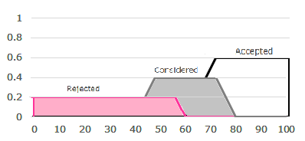
Step 4: Choose Defuzzification Method
Center of Gravity (Mamdani-style)
Clipping using MAX-MIN method to “chop off” parts of Membership based on the fuzzy output obtained from rule inferencing, then Aggregate the clipped membership
For example, we obtained fuzzy output
Rejected(0.2)
Considered(0.4)
Accepted(0.6)
Notes:
Then we need to "chop off" the membership from the rule inference output.
We'll discuss how exactly to do this later with concrete example.

Slide 52

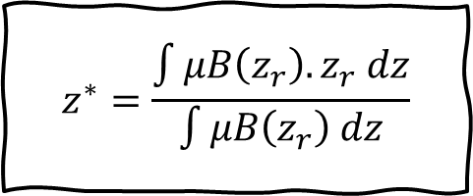
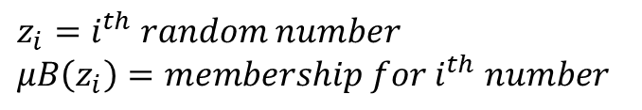
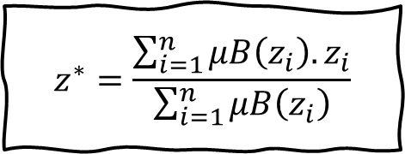
Step 4: Choose Defuzzification Method
Center of Gravity (Mamdani-style)
Calculate center of gravity using
If the crisp values ($z_{r}$) are discrete, we can replace integration with summation
$$z^{∗}=\frac{\int{μB\left(z_{r}\right).z_{r} dz}}{\int{μB\left(z_{r}\right) dz}}$$
$$z^{∗}=\frac{\sum_{i=1}^{n}{μB\left(z_{i}\right). z_{i}}}{\sum_{i=1}^{n}{μB\left(z_{i}\right)}}$$
$z_{i}=i^{th} random number$
$μB\left(z_{i}\right)=membership for i^{th} number$
Notes:
[skip]

Slide 53
Step 4: Choose Defuzzification Method
Constant Defuzzification (Takagi-Sugeno-style)
Choose a constant value to represent each output linguistic
For example, set the constant value to 50, 70, and 100
Notes:
With Takagi-Sugeno style, we don't need to make output membership functions,
but simply define a constant number value for each output linguistic.
For example here:
Rejected is 50.
Considered is 70.
and Accepted is 100.
As you can imagine, Takagi-Sugeno is simpler to understand and implement.
So if you're confused with Mamdani,
I suggest you use this one. Your fuzzy logic implementation will still be correct.

Slide 54
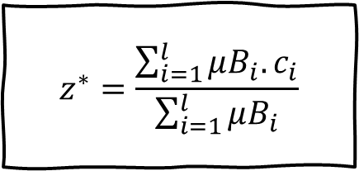
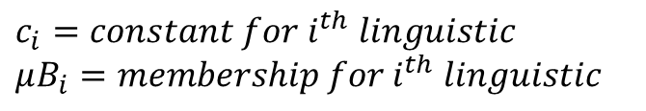
Step 4: Choose Defuzzification Method
Constant Defuzzification (Takagi-Sugeno-style)
Using fuzzy output obtained from rule inferencing
Calculate crisp output using
$$z^{∗}=\frac{\sum_{i=1}^{l}{μB_{i}. c_{i}}}{\sum_{i=1}^{l}{μB_{i}}}$$
$c_{i}=constant for i^{th} linguistic$
$μB_{i}=membership for i^{th} linguistic$
Notes:
[skip]
------------------------------------

Slide 55
Fuzzy System for Scholarship Selection
Test to an example
Notes:
So let's use a real example with real numbers ya.
The scholarship selection.

Slide 56
Case Example
Student A has GPA of 3.01 with Parental Income of 14M
Student B has GPA of 2.90 with Parental Income of 5.5M
Notes:
For this example we will compare two students, A and B.
Student A has GPA of 3.01 with Parental Income of 14M
Student B has GPA of 2.90 with Parental Income of 5.5M
Our job is to find out the output score of each student using fuzzy logic.
So if we only accept 1 student, which one will get accepted?

Slide 57
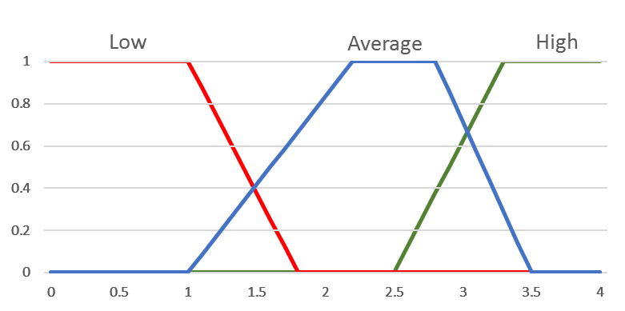
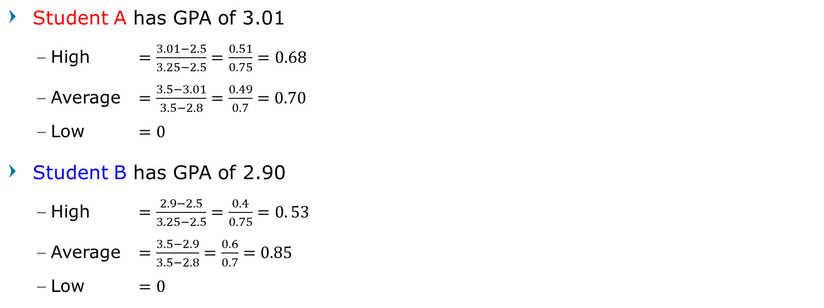
Fuzzification - GPA
Student A has GPA of 3.01
High $=\frac{3.01−2.5}{3.25−2.5}=\frac{0.51}{0.75}=0.68$
Average $=\frac{3.5−3.01}{3.5−2.8}=\frac{0.49}{0.7}=0.70$
Low $=0$
Student B has GPA of 2.90
High $=\frac{2.9−2.5}{3.25−2.5}=\frac{0.4}{0.75}=0. 53$
Average $=\frac{3.5−2.9}{3.5−2.8}=\frac{0.6}{0.7}=0.85$
Low $=0$
Notes:
First, we design the INPUT membership functions.
This is as in the previous slides.
So the GPA numbers for each student, we evaluate the formula,
for example this one is membership function for High, for Student A, and this one for Student B.
this one is membership function for Average, for Student A, and this one for Student B.
this one is membership function for Low, for Student A, and this one for Student B.
Now we have fuzzy values ya for each student,
but only for GPA input linguistic variable.
Are we finished? Not yet, because we have another input linguistic variable,
and that is Income.
So let's calculate fuzzy values for Income.

Slide 58
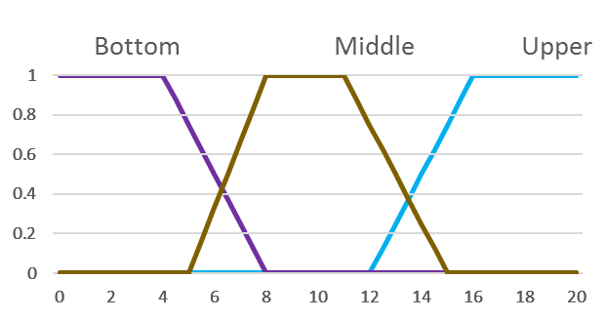

Fuzzification - Income
Student A has Parental Income of 14M
Upper $=\frac{14−12}{16−12}=\frac{2}{4}=0.5$
Middle $=\frac{15−14}{15−11}=\frac{1}{4}=0.25$
Bottom $=0$
Student B has Parental Income of 5.5M
Upper $=0$
Middle $=\frac{5.5−5}{8−5}=\frac{0.5}{3}=0.167$
Bottom $=\frac{8−5.5}{8−4}=\frac{2.5}{4}=0.625$
Notes:
So the Parental Income numbers for each student, we evaluate the formula,
for example this one is Parental Income membership function for Upper, for Student A, and this one for Student B.
this one is Parental Income membership function for Middle, for Student A, and this one for Student B.
this one is Parental Income membership function for Bottom, for Student A, and this one for Student B.
Alright, we have all the input fuzzy values. What next?
Yup. We need to define the rules, to map (or perform inference)
from INPUT fuzzy values, into OUTPUT fuzzy values.

Slide 59
Inference
Apply the inference rule to the fuzzy inputs to obtain the fuzzy output
Using Clipping technique, the conjunction rule will get the minimum value of fuzzy input as the fuzzy output
For example, for Student A, we will get
if GPA='High(0.68)' and Income='Bottom(0)' then Score='Accepted(0)’
...
if GPA='Average(0.70)' and Income='Middle(0.25)' then Score='Considered(0.25)’
...
if GPA=‘Low(0)' and Income='Upper(0.5)' then Score='Rejected(0)’
...
Notes:
This is the Inference step.
In this step, we need to use the clipping rule.
We look for each relevan combination from the rule table,
and we put the input fuzzy values there,
then the output score will be the MINIMUM from the input values.
Let's see an example.

Slide 60
Inference
Thus we have
Student A
GPA |  | Income |  | Score
High | 0.68 | Upper | 0.5 | Considered | 0.5
High | 0.68 | Middle | 0.25 | Accepted | 0.25
High | 0.68 | Bottom | 0 | Accepted | 0
Average | 0.70 | Upper | 0.5 | Considered | 0.5
Average | 0.70 | Middle | 0.25 | Considered | 0.25
Average | 0.70 | Bottom | 0 | Accepted | 0
Low | 0 | Upper | 0.5 | Rejected | 0
Low | 0 | Middle | 0.25 | Rejected | 0
Low | 0 | Bottom | 0 | Considered | 0
Student B
GPA |  | Income |  | Score
High | 0.53 | Upper | 0 | Considered | 0
High | 0.53 | Middle | 0.167 | Accepted | 0.167
High | 0.53 | Bottom | 0.625 | Accepted | 0.53
Average | 0.85 | Upper | 0 | Considered | 0
Average | 0.85 | Middle | 0.167 | Considered | 0.167
Average | 0.85 | Bottom | 0.625 | Accepted | 0.625
Low | 0 | Upper | 0 | Rejected | 0
Low | 0 | Middle | 0.167 | Rejected | 0
Low | 0 | Bottom | 0.625 | Considered | 0
Notes:
For Student A, the GPA-High membership is 0.68, and Income-Upper membership is 0.5.
From the rule table, we know the GPA-High and Income-Upper, becomes Score-Considered.
The Score-Considered output fuzzy value is 0.5,
because that is the minimum between 0.68 and 0.5.
Then you apply the same method for all other cells here.
Before we go to the next slide,
please hold in your mind,
that for Student A, output Score-Accepted has three fuzzy values here,
0.25, 0, and 0.
We'll use that in the next slide.

Slide 61
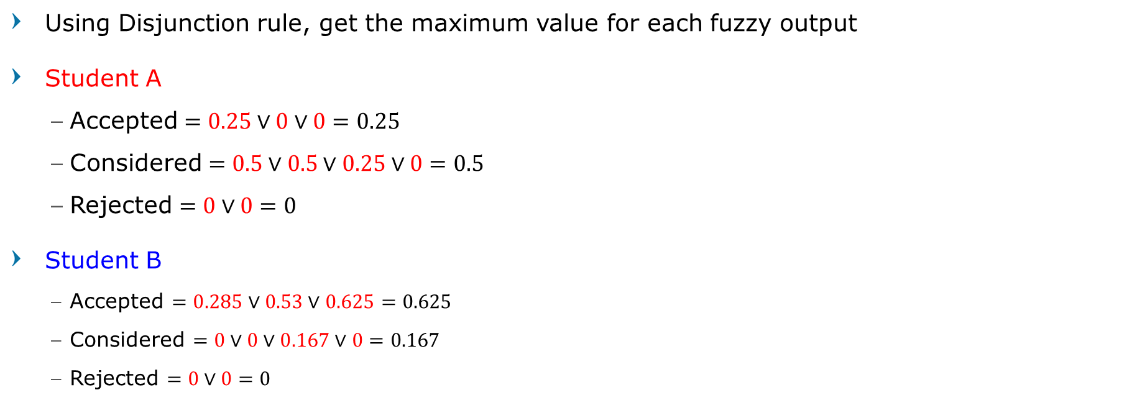
Inference
Using Disjunction rule, get the maximum value for each fuzzy output
Student A
Accepted $=0.25∨0∨0=0.25$
Considered $=0.5∨0.5∨0.25∨0=0.5$
Rejected $=0∨0=0$
Student B
Accepted $=0.285∨0.53∨0.625=0.625$
Considered $=0∨0∨0.167∨0=0.167$
Rejected $=0∨0=0$
Notes:
After that, we need to get the fuzzy values for each output linguistic.
The way we do it, is my getting the MAXIMUM value for each fuzzy output linguistic.
As you recall from previous slide,
for Student A, output Score-Accepted, the values are 0.25, 0, and 0.
So the maximum from these three numbers, are 0.25.
Now we do we same for Considered, and Rejected.
So the fuzzy output values for Student A are:
Accepted is 0.25, Considered is 0.5, and Rejected is 0.
We do the same for Student B.

Slide 62
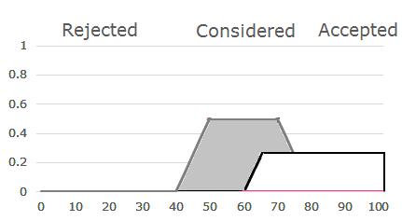
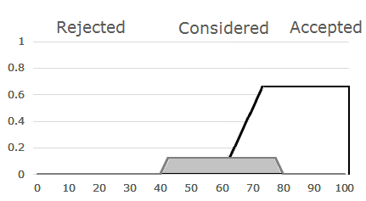

Defuzzification – Mamdani
Using Clipping technique, we will get
Student A
Accepted $=0.25$
Considered $=0.5$
Rejected $=0$
Student B
Accepted $=0.625$
Considered $=0.167$
Rejected $=0$
Notes:
The last step is Defuzzification.
Let's try Mamdani first.
Remember when using Mamdani, we have to design OUTPUT member functions.
When applying Mamdani, we clip the results from each function.
So for Accepted output member function, the results are clipped at 0.25.
So for Considered output member function, the results are clipped at 0.5.
And for Rejected output member function, the results are clipped at 0,
meaning that you don't see anything here right.
You do the same for Student B.
We'll review this in more detail in the next slides.

Slide 63
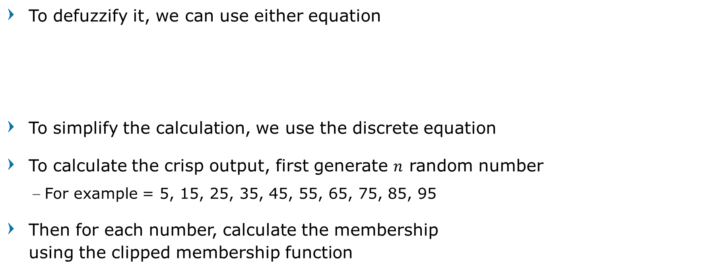
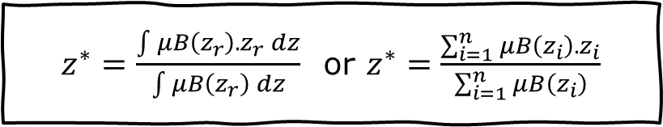
Defuzzification – Mamdani
To defuzzify it, we can use either equation
To simplify the calculation, we use the discrete equation
To calculate the crisp output, first generate $n$ random number
For example = 5, 15, 25, 35, 45, 55, 65, 75, 85, 95
Then for each number, calculate the membership using the clipped membership function
$z^{∗}=\frac{\int{μB\left(z_{r}\right).z_{r} dz}}{\int{μB\left(z_{r}\right) dz}}$ or $z^{∗}=\frac{\sum_{i=1}^{n}{μB\left(z_{i}\right). z_{i}}}{\sum_{i=1}^{n}{μB\left(z_{i}\right)}}$
Notes:
This is the equation for Mamdani defuzzification.
To calculate the crisp output that is Score, we can generate n random number, for example 10 random numbers.
And then we clip the numbers.
Let's see what we mean by clipping the numbers.

Slide 64
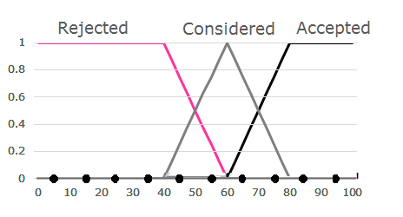
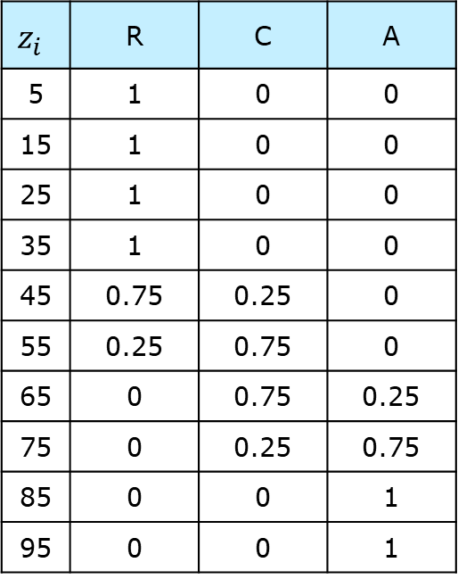
Defuzzification – Mamdani
$$z_{i}$$ | R | C | A
5 | 1 | 0 | 0
15 | 1 | 0 | 0
25 | 1 | 0 | 0
35 | 1 | 0 | 0
45 | 0.75 | 0.25 | 0
55 | 0.25 | 0.75 | 0
65 | 0 | 0.75 | 0.25
75 | 0 | 0.25 | 0.75
85 | 0 | 0 | 1
95 | 0 | 0 | 1
First calculate the membership of each random generated number using the designed output Membership Function
Notes:
We have z_i from 5, 15, … to 95.
So we evaluate the OUTPUT membership function using these numbers.
This table is what we get.

Slide 65
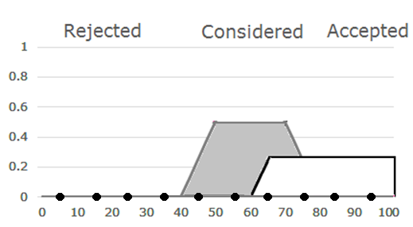

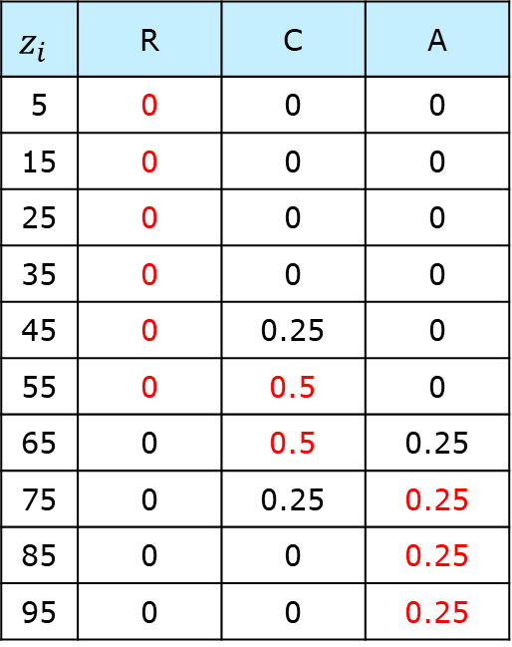
Defuzzification – Mamdani
$$z_{i}$$ | R | C | A
5 | 0 | 0 | 0
15 | 0 | 0 | 0
25 | 0 | 0 | 0
35 | 0 | 0 | 0
45 | 0 | 0.25 | 0
55 | 0 | 0.5 | 0
65 | 0 | 0.5 | 0.25
75 | 0 | 0.25 | 0.25
85 | 0 | 0 | 0.25
95 | 0 | 0 | 0.25
Maximized (threshold) the value based on the clipped membership
Student A
Accepted $=0.25$, Considered $=0.5$, Rejected $=0$
Notes:
Now, we clip these numbers, based on our fuzzy output values before.
So for Accepted, it means all numbers greater than 0.25, become 0.25.
For Considered, all numbers greater than 0.5, become 0.5.
For Rejected, well since this is zero, then everything becomes 0 here.

Slide 66

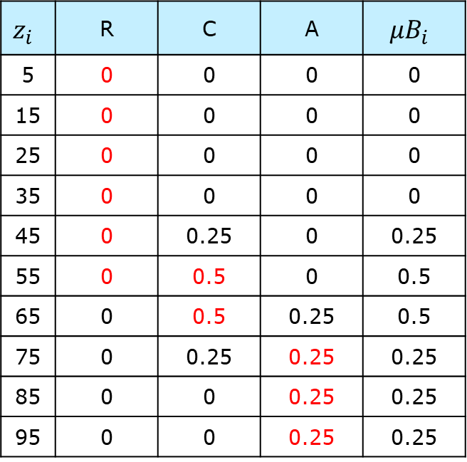
Defuzzification – Mamdani
$$z_{i}$$ | R | C | A | $$μB_{i}$$
5 | 0 | 0 | 0 | 0
15 | 0 | 0 | 0 | 0
25 | 0 | 0 | 0 | 0
35 | 0 | 0 | 0 | 0
45 | 0 | 0.25 | 0 | 0.25
55 | 0 | 0.5 | 0 | 0.5
65 | 0 | 0.5 | 0.25 | 0.5
75 | 0 | 0.25 | 0.25 | 0.25
85 | 0 | 0 | 0.25 | 0.25
95 | 0 | 0 | 0.25 | 0.25
Output Membership is the maximum value from each linguistic
Student A
Accepted $=0.25$, Considered $=0.5$, Rejected $=0$
Notes:
Now the output values for each row here,
are the MAXIMUM value from Accepted, Considered, and Rejected.
Let's take a look for z_i=45 here.
Since between Rejected=0, Considered=0.25, Accepted=0, the maximum is 0.25,
so the output for z_i=45 becomes 0.25.
We do this for all z_i values.

Slide 67

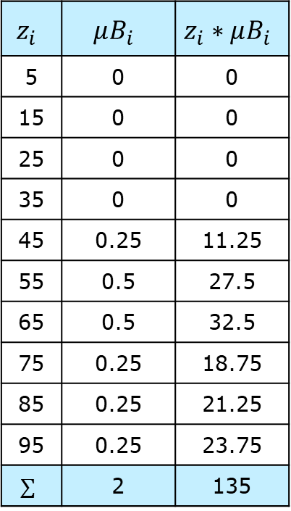
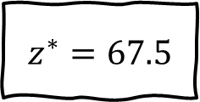


Defuzzification – Mamdani
$$z_{i}$$ | $$μB_{i}$$ | $$z_{i}∗μB_{i}$$
5 | 0 | 0
15 | 0 | 0
25 | 0 | 0
35 | 0 | 0
45 | 0.25 | 11.25
55 | 0.5 | 27.5
65 | 0.5 | 32.5
75 | 0.25 | 18.75
85 | 0.25 | 21.25
95 | 0.25 | 23.75
$$∑$$ | 2 | 135
Lastly, calculate the crisp output using equation
Student A
$$z^{∗}=\frac{\sum_{i=1}^{n}{μB\left(z_{i}\right). z_{i}}}{\sum_{i=1}^{n}{μB\left(z_{i}\right)}}$$
$z^{∗}=\frac{\begin{aligned}\left(5∗0\right)+\left(15∗0\right)+\left(25∗0\right)+\left(35∗0\right)+\left(45∗0.25\right)+ \\ \left(55∗0.5\right)+\left(65∗0.5\right)+\left(75∗0.25\right)+\left(85∗0.25\right)+\left(95∗0.25\right)\end{aligned}}{0+0+0+0+0.25+0.5+0.5+0.25+0.25+0.25}$
$z^{∗}=\frac{11.25+27.5+32.5+21.25+23.75}{2}=\frac{135}{2}$
$z^{∗}=67.5$
Notes:
Last, we use the Mamdani equation and use all the numbers here.
5 * 0 becomes 0,
15 * 0 becomes 0,
25 * 0 becomes 0,
35 * 0 becomes 0,
45 * 0.25 becomes 11.25,
and so on.
The lower part here, is the sum of all the uB(zi) numbers.
So it's 135 divided by 2.
Finally, the Score Crisp Value for Student A, is 67.5.
That's it! That's the final score!
Let's do the same for Student B.

Slide 68



Defuzzification – Mamdani
$$z_{i}$$ | R | C | A | $$μB_{i}$$
5 | 0 | 0 | 0 | 0
15 | 0 | 0 | 0 | 0
25 | 0 | 0 | 0 | 0
35 | 0 | 0 | 0 | 0
45 | 0 | 0.167 | 0 | 0.167
55 | 0 | 0.167 | 0 | 0.167
65 | 0 | 0.167 | 0.25 | 0.25
75 | 0 | 0.167 | 0.625 | 0.625
85 | 0 | 0 | 0.625 | 0.625
95 | 0 | 0 | 0.625 | 0.625
Do the same for Student B
Student B
Accepted $=0.625$, Considered $=0.167$, Rejected $=0$
Notes:
[skip]

Slide 69




Defuzzification – Mamdani
$$z_{i}$$ | $$μB_{i}$$ | $$z_{i}∗μB_{i}$$
5 | 0 | 0
15 | 0 | 0
25 | 0 | 0
35 | 0 | 0
45 | 0.17 | 7.515
55 | 0.17 | 9.185
65 | 0.25 | 16.25
75 | 0.63 | 46.875
85 | 0.63 | 53.125
95 | 0.63 | 59.375
$$∑$$ | 2.459 | 192.325
Lastly, calculate the crisp output using equation
Student B
$$z^{∗}=\frac{\sum_{i=1}^{n}{μB\left(z_{i}\right). z_{i}}}{\sum_{i=1}^{n}{μB\left(z_{i}\right)}}$$
$z^{∗}=\frac{\begin{aligned}\left(5∗0\right)+\left(15∗0\right)+\left(25∗0\right)+\left(35∗0\right)+\left(45∗0.167\right)+\left(55∗0.167\right) \\ +\left(65∗0.25\right)+\left(75∗0.625\right)+\left(85∗0.625\right)+\left(95∗0.625\right)\end{aligned}}{0+0+0+0+0.167+0.167+0.25+0.625+0.625+0.625}$
$z^{∗}=\frac{7.51+9.18+16.25+46.87+53.12+59.37}{2.459}=\frac{192.325}{2.459}$
$z^{∗}=78.21$
Notes:
And using the same method, Student B gets a Score of 78.21.

Slide 70




Defuzzification – Mamdani
Apply the fuzzy output to the equation
Student A
Student B
$z^{∗}=\frac{11.25+27.5+32.5+21.25+23.75}{2}$
$z^{∗}=\frac{135}{2}$
$z^{∗}=67.5$
$z^{∗}=\frac{7.51+9.18+16.25+46.87+53.12+59.37}{2.459}$
$z^{∗}=\frac{192.325}{2.459}$
$z^{∗}=78.21$
Notes:
Now we have the output Score crisp values,
it's easy to know, who has priority to get the scholarship, right?
It is Student B, because he/she has 78.21,
and Student A got 67.5.
If you have many students, and many scholarship slots,
then you do the same thing, and you sort based on biggest Output Scores,
and the students with the top Scores get the scholarship,
and the rest will be rejected.
So that's it if our defuzzification method is using Mamdani.
Let's see what if we're using Sugeno instead?

Slide 71



Defuzzification – Sugeno
Apply the fuzzy output to the equation
Student A
Accepted $=0.25$
Considered $=0.5$
Rejected $=0$
Student B
Accepted $=0.625$
Considered $=0.167$
Rejected $=0$
$$z^{∗}=\frac{\sum_{i=1}^{l}{μB_{i}. c_{i}}}{\sum_{i=1}^{l}{μB_{i}}}$$
Notes:
Using Sugeno defuzzification is simpler.
So these are the fuzzy output values for Student A,
and these are for Student B.
With Sugeno defuzzification, we need to set values for each output linguistic.
Here, we set Score 50 as Rejected, Score 70 as Considered,
and Score 100 as Accepted.
This is the Sugeno formula, that we'll show you shortly.

Slide 72




Defuzzification – Sugeno
Apply the fuzzy output to the equation
Student A
Student B
$z^{∗}=\frac{\left(0.25∗100\right)+\left(0.5∗70\right)+(0∗50)}{0.25+0.5+0}$
$z^{∗}=\frac{25+35+0}{0.75}$
$$z^{∗}=80$$
$z^{∗}=\frac{\left(0.625∗100\right)+\left(0.167∗70\right)+(0∗50)}{0.625+0.167+0}$
$z^{∗}=\frac{62.5+11.69+0}{0.792}$
$$z^{∗}=93.67$$
Notes:
So what you do is you multiply the Student's fuzzy output values,
to the linguistic membership value.
So Student A's Accepted is 0.25, you multiply by the Accepted output membership value that is 100.
You also multiply for Considered that is 70, and for Rejected that is 50.
And the bottom part, you sum all of the Student A's fuzzy output values.
Then you get Student A's score is 80.
With same method, you get Student B's score is 93.67.
Who gets the priority for scholarship? Yes that's right, Student B again.
As you can see, the output scores are different with Sugeno, than with Mamdani.
But in this case, the decision is still the same, that Student B gets priority.
However, if the output membership design is very different,
it's possible that Sugeno will output different result than Mamdani.
Which is okay, as long as you implement the algorithm correctly.
Alright my friends, and that's it our discussion about Fuzzy Logic algorithm.
I hope this is pretty clear for you.
After this it will be time for you to code a program,
and implement the Fuzzy Logic algorithm,
using Python programming language.
See you again in the next topic.
I'm Hendy Irawan. Wassalaamu'alaikum warohmatullahi wabarokatuh.

Slide 73
Question?

